Slide 1

The Griffith Scholars Hub VIVO Extensions
VIVO14 | Austin,Texas
Arve Solland
Senior Programmer / Business Analyst
eResearch Services
Griffith University, Australia

Slide 2
Agenda
Background
The Griffith Scholars Hub Project
Data Ingest
External Data Linking
Visualisations
Edit Interface Changes
Dynamic Micro Portal / Lenses
Challenges
The road ahead

Slide 3
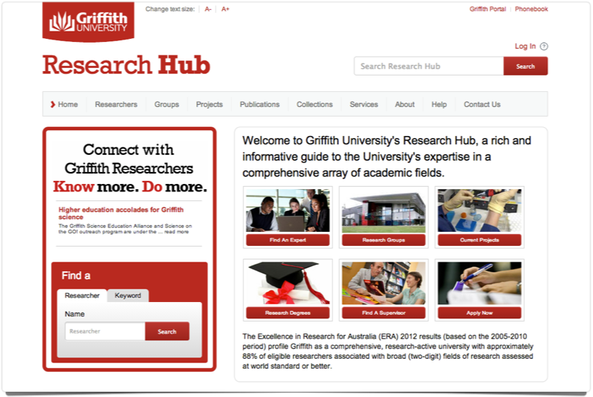
The Griffith Research Hub
http://research-hub.griffith.edu.au/

Slide 4
The Research Hub
Griffith University’s VIVO instance
Currently contains landing pages for:
1200+ profiled researchers
64000+ publications
6400+ projects/grants
groups, data collections and services

Slide 5
The Scholars Hub
The Research Hub has been live since February 2012, and is currently running VIVO 1.5.1
A project is underway to transform the current Research Hub into the Griffith Scholars Hub, which will generate profile pages for all scholars at Griffith University.
This change will generate extra data volume and load on applications servers, so a range of optimisations and improvements are being implemented.

Slide 6
Data Ingest
The hub currently has nightly feeds from University source systems:
Research Data Repository (Equella)
Griffith Research Online research publications repository (DSpace)
Metadirectory (incl Human resources (people and groups) database)
Research Administration Database (Office for Research)

Slide 7
Difference Model
Nightly data ingest currently produces a end product of approx. 5.7 million triples, which are loaded into separate graphs in VIVO, based on their source system and data type.
To prevent high load on the application and database server during ingest, we created a python script that generates a difference model for each datasource.
The python script compares two RDF files (current and yesterday’s ingest files) and generates a set of changes.
Only the changes from current ingest (normally 24 hours ago) is actually loaded into the triple store.
Files with the generated RDF change sets are stored for traceability.

Slide 8
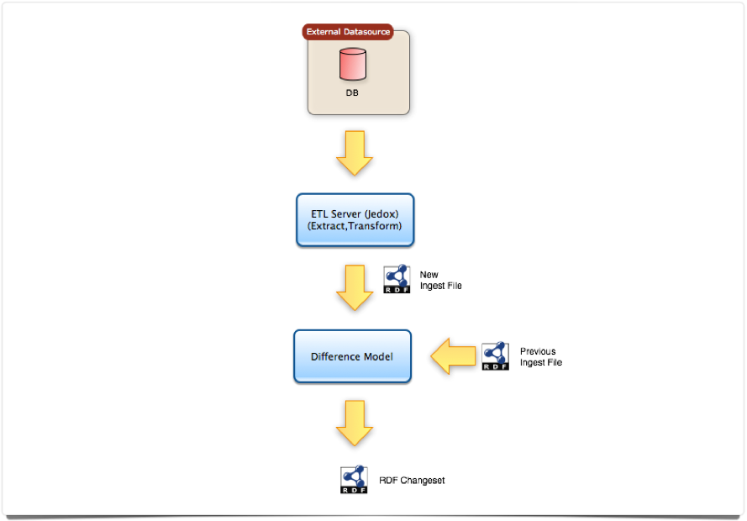
Difference Model Flow

Slide 9
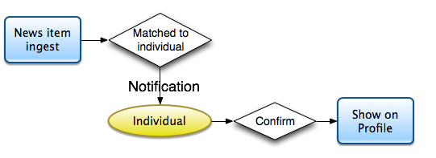
External data linking
As we have developed a news ingest module which can scrape news feeds and create possible relations to individuals in the hub, we need a way for the individuals to confirm that the relation is correct before we can show the news item on their profile.
A linked data notification workflow will be implemented, where the user will receive an email when new items are found, and also show alerts when the user is logging in, asking them to confirm whether the links are correct.

Slide 10
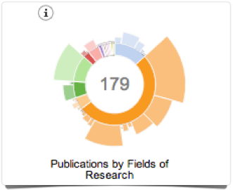
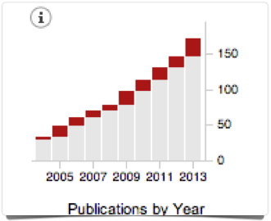
Visualisations
Some interactive visualisations created for a person, using the d3.js ( http://d3js.org/ ) javascript library.
Publications by field of research
Publication By Year

Slide 11
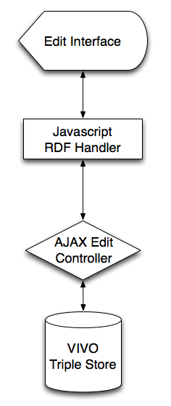
Edit Interface Changes
As the standard edit interface for certain properties were taking a very long time to load (20sec+), we have changed how the edit interfaces load and save data.
Now, the edit interfaces only loads the bare minimum of through the Java form generator. The rest of the data needed is ‘lazy loaded” through one or more ajax calls after the initial page load.
This ensures that the user gets a responding edit interface almost immediately.
RDF structure of data sent and received to the edit interface is handled by a javascript middle layer.
Data save requests are also handled by one or more ajax calls.

Slide 12
Dynamic Micro Portals / Lenses
Since we first implemented VIVO, we saw the potential for pages showing data from dynamic/aggregated queries.
Now we have had direct business requirements to create pages within the hub which can display a select set of the data with particular interface functionality.
We have call these dynamic pages a Micro Portal or a Lens.
A lens within the Hub will be able to show dynamic results of a query, in a specified interface.
The first lens developed for the hub was: “Griffith In Asia”. This lens displays individuals in the hub that have some involvement in the Asia-Pacific region.

Slide 13
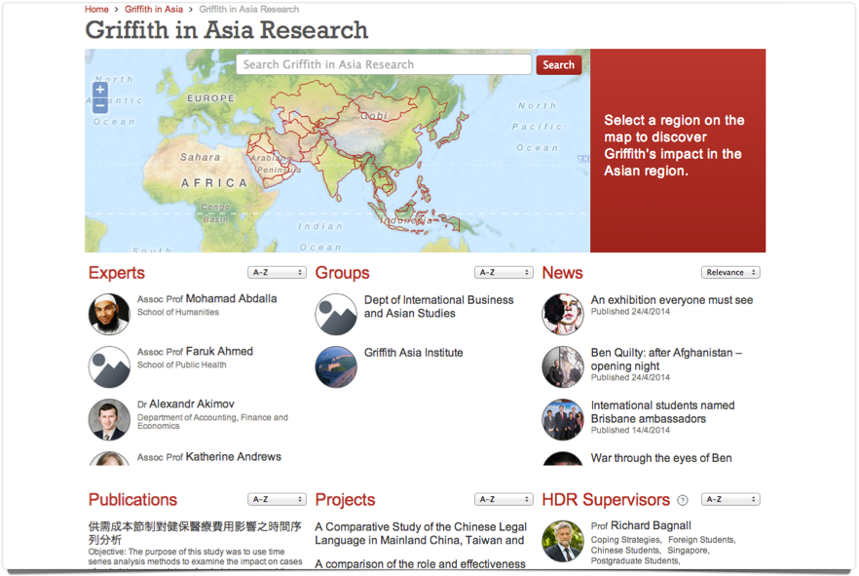
Dynamic Micro Portals / Lenses
http://research-hub.griffith.edu.au/griffith-in-asia
Griffith In Asia Lens interface

Slide 14
Dynamic Micro Portals / Lenses
The Griffith In Asia lens has the following features:
Interactive map that allows user to select a country to see related individuals.
Page shows all individuals related to the lens, grouped by type (Experts, Groups, Projects, Publications etc)
Search functionality allows user to perform keyword search within lens items.
Admin functionality
Individuals can be ‘tagged’ to a lens either via automated queries, via direct edit of an individual, or through a bulk edit interface developed especially for the lens functionality.

Slide 15
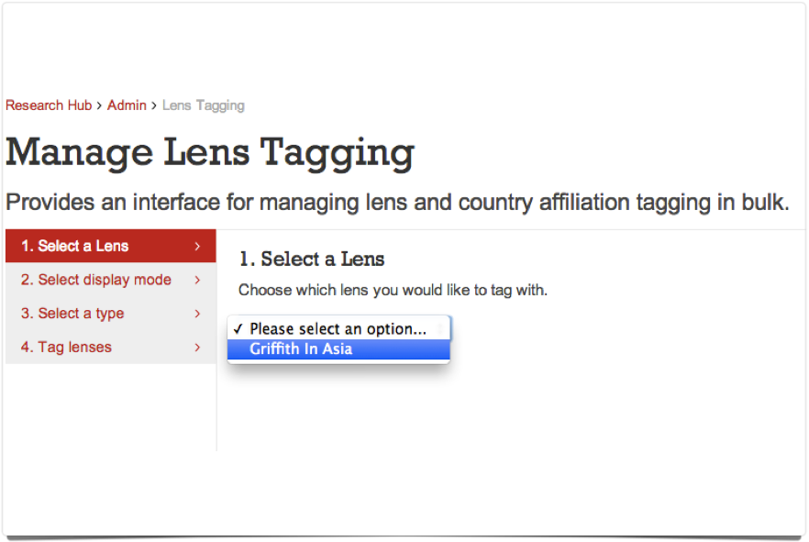
Dynamic Micro Portals / Lenses
Bulk Edit Interface for lenses - Step 1 - Select Lens

Slide 16
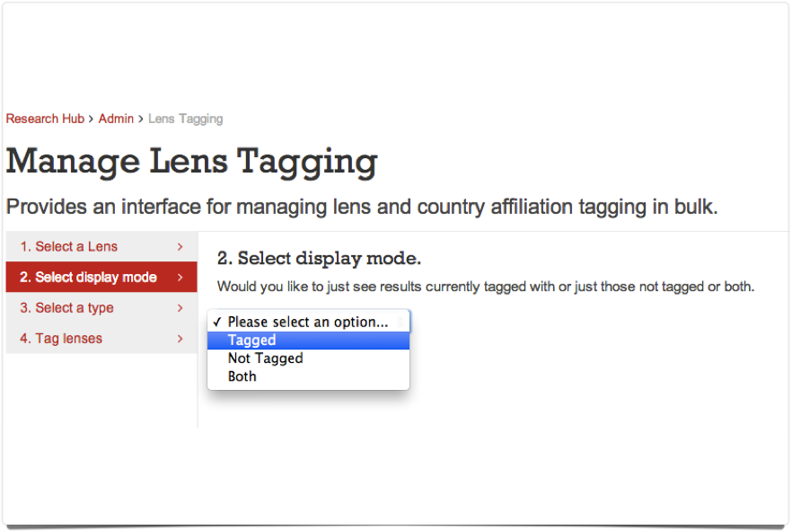
Dynamic Micro Portals / Lenses
Bulk Edit Interface for lenses - Step 2 - Select Display Mode

Slide 17
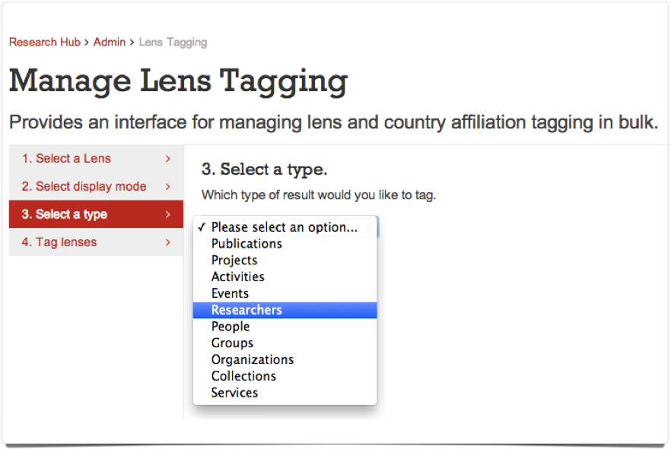
Dynamic Micro Portals / Lenses
Bulk Edit Interface for lenses - Step 3 - Select Type

Slide 18
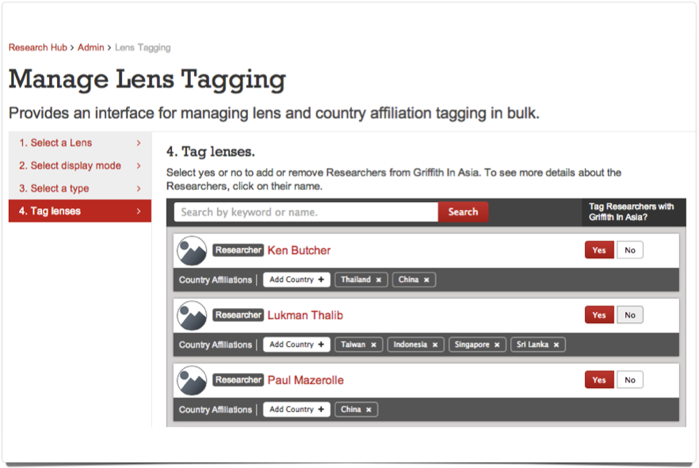
Dynamic Micro Portals / Lenses
Bulk Edit Interface for lenses - Step 4 - Tag Individuals

Slide 19
Dynamic Micro Portals / Lenses
We initially wanted to use the built in functionality in VIVO to create dynamic pages displaying the results of SPARQL queries.
But when queries got complex, or query results got more than 1000 results, we ran in to performance issues. We just could not get a quick enough results back from the SPARQL queries when loading items on the page.
By querying solr directly using filter queries, instead of using SPARQL queries, we ensure a near instant response and can render the items on the page much faster.
The SPARQL queries that we needed could easily be replaced by one or more solr queries for much better performance, and also causing less load on the application server.

Slide 20
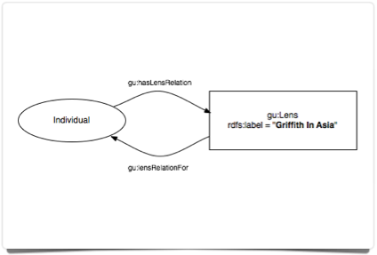
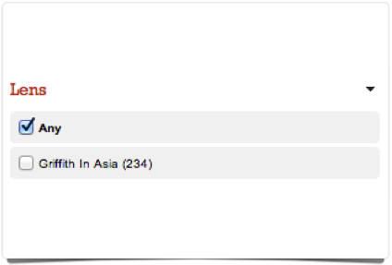
Dynamic Micro Portals / Lenses
RDF Structure for lens relations
New Search facet for lenses

Slide 21

Challenges
VIVO 1.6 (VIVO-ISF) Upgrade
SSO/https institution compliance
Jena Mysql performance issues

Slide 22
The Road Ahead
VIVO 1.6 upgrade (VIVO-ISF)
Redesign and restructuring of display template to create a fully responsive design.
Improve SEO for all pages.
Integrate linked data notification model.
New and changed data sources.
Further development of lenses/micro portals.
Evaluate change of storage backend to a triple store such as 4store/Virtuoso.

Slide 23
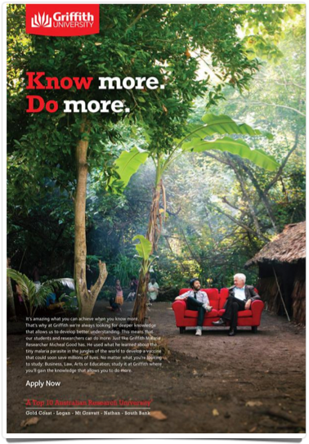
Questions ?
Thank you

